Slide 1
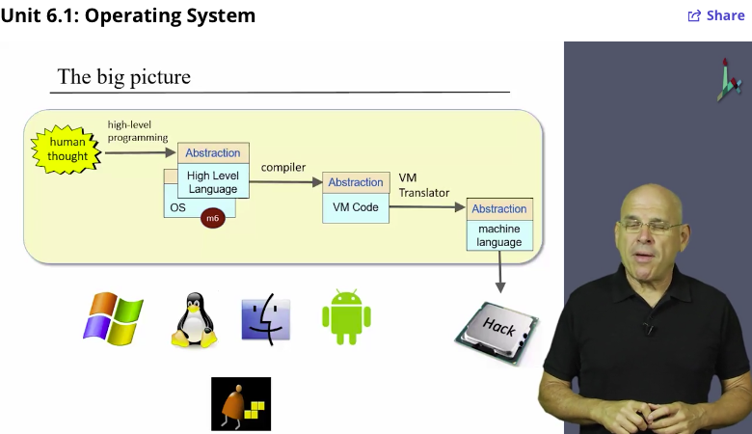
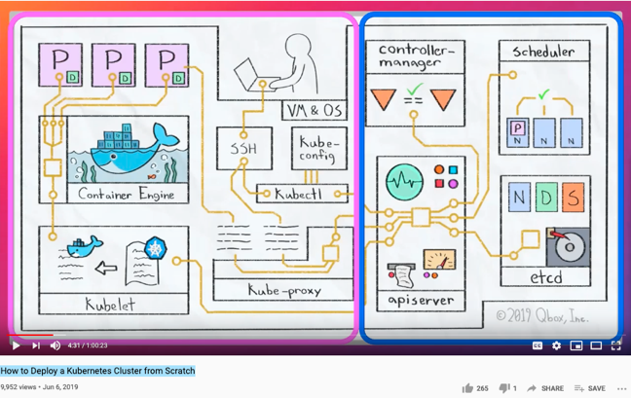
Computational Thinking & Systems Design Lecture 12 Operating System: from bare minimum to distributed systems
Ben Koo
December 1, 2020

Slide 2
Where we are at:
Human
Abstract design
Software
Thought
abstract interface
hierarchy
Chapters 9, 12
H.L. Language
Compiler
&
abstract interface
Operating Sys.
Chapters 10 - 11
Virtual
VM Translator
Machine
abstract interface
Chapters 7 - 8
Assembly
Language
Assembler
Chapter 6
abstract interface
Computer
Machine
Architecture
Language
abstract interface
Chapters 4 - 5
Gate Logic
Hardware
abstract interface
Platform
Chapters 1 - 3
Electrical
Hardware
Chips &
Engineering
Logic Gates
Physics
hierarchy

Slide 3
No Royal Road to Geometry. Euclid

Slide 4
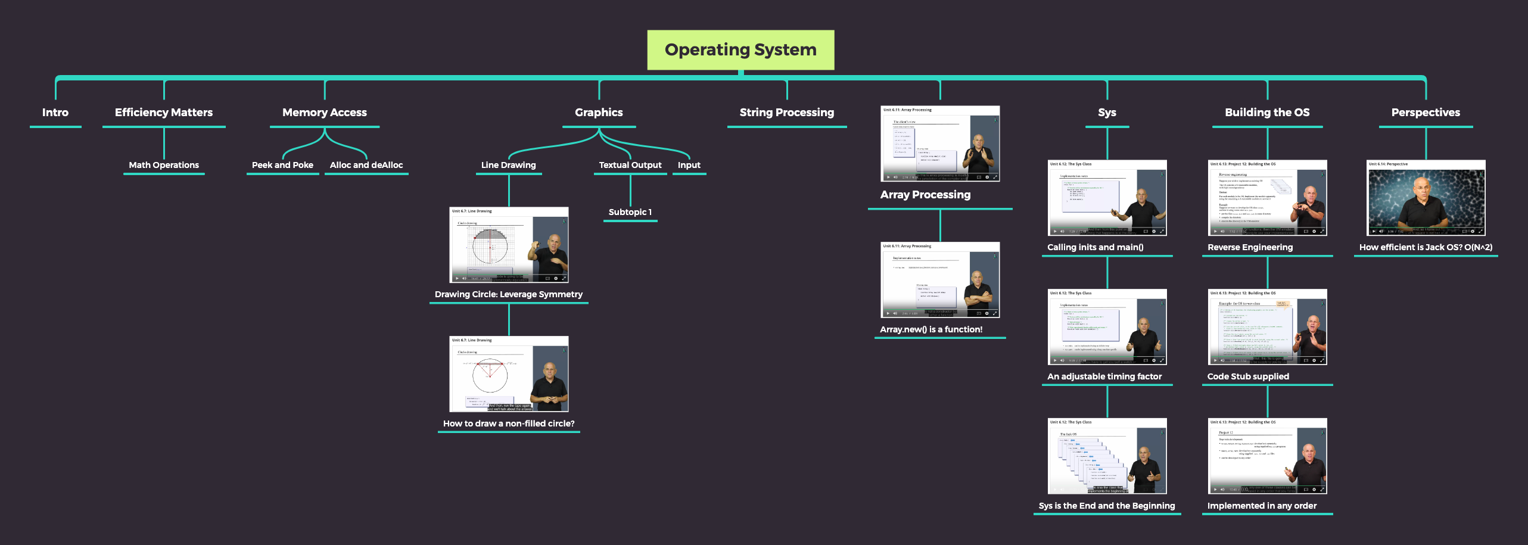
The Key Ideas in Shocken’s Lecture

Slide 5
Jack revisited
/** Computes the average of a sequence of integers. */
class Main {
function void main() {
var Array a;
var int length;
var int i, sum;
let length = Keyboard.readInt(”How many numbers? ”);
let a = Array.new(length); // Constructs the array
let i = 0;
while (i < length) {
let a[i] = Keyboard.readInt(”Enter the next number: ”);
let sum = sum + a[i];
let i = i + 1;
}
do Output.printString(”The average is: ”);
do Output.printInt(sum / length);
do Output.println();
return;
}
}

Slide 6
Jack revisited
/** Computes the average of a sequence of integers. */
class Main {
function void main() {
var Array a;
var int length;
var int i, sum;
let length = Keyboard.readInt(”How many numbers? ”);
let a = Array.new(length); // Constructs the array
let i = 0;
while (i < length) {
let a[i] = Keyboard.readInt(”Enter the next number: ”);
let sum = sum + a[i];
let i = i + 1;
}
do Output.printString(”The average is: ”);
do Output.printInt(sum / length);
do Output.println();
return;
}
}

Slide 7
Typical OS functions
Language extensions / standard library
Mathematical operations (abs, sqrt, ...)
Abstract data types (String, Date, ...)
Output functions (printChar, printString ...)
Input functions (readChar, readLine ...)
Graphics functions (drawPixel, drawCircle, ...)
And more ...
System-oriented services
Memory management (objects, arrays, ...)
I/O device drivers
Mass storage
File system
Multi-tasking
UI management (shell / windows)
Security
Communications
And more ...

Slide 8
The Jack OS
Math: Provides basic mathematical operations;
String: Implements the String type and string-related operations;
Array: Implements the Array type and array-related operations;
Output: Handles text output to the screen;
Screen: Handles graphic output to the screen;
Keyboard: Handles user input from the keyboard;
Memory: Handles memory operations;
Sys: Provides some execution-related services.

Slide 9
Jack OS API
class Math {
function void init()
function int abs(int x)
function int multiply(int x, int y)
function int divide(int x, int y)
function int min(int x, int y)
function int max(int x, int y)
function int sqrt(int x)
}
Class String {
constructor String new(int maxLength)
method void dispose()
method int length()
method char charAt(int j)
method void setCharAt(int j, char c)
method String appendChar(char c)
method void eraseLastChar()
method int intValue()
method void setInt(int j)
function char backSpace()
function char doubleQuote()
function char newLine()
}
Class Array {
function Array new(int size)
method void dispose()
}
class Output {
function void moveCursor(int i, int j)
function void printChar(char c)
function void printString(String s)
function void printInt(int i)
function void println()
function void backSpace()
}
Class Screen {
function void clearScreen()
function void setColor(boolean b)
function void drawPixel(int x, int y)
function void drawLine(int x1, int y1, int x2, int y2)
function void drawRectangle(int x1, int y1, int x2, int y2)
function void drawCircle(int x, int y, int r)
}
class Memory {
function int peek(int address)
function void poke(int address, int value)
function Array alloc(int size)
function void deAlloc(Array o)
}
Class Keyboard {
function char keyPressed()
function char readChar()
function String readLine(String message)
function int readInt(String message)
}
Class Sys {
function void halt():
function void error(int errorCode)
function void wait(int duration)
}

Slide 10
A typical OS:
Is modular and scalable
Empowers programmers (language extensions)
Empowers users (file system, GUI, ...)
Closes gaps between software and hardware
Runs in “protected mode”
Typically written in some high level language
Typically grows gradually, assuming more and more functions
Must be efficient.

Slide 11
Success Criteria
Running Time Analysis (Performance/Efficiency)
Resource Allocation
Input Handling
Vector Graphics
Textual Outputs
Type Conversions
String Processing
.

Slide 12
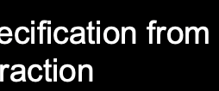
Abstraction
Separate Specification from Abstraction
Concretization
Why is abstraction useful?
Allow reuse through universal properties
Avoid resource conflicts
Scale free and domain neutral
Generalizing concrete experience?
Make analogies in localized contexts
Engage sensible metaphors
Define terms and boundaries
A well-defined set of Actions and iterative Branching Strategies
A Roadmap of composable activities
Sequencing and timing conditions
Explicitly state dependencies and resource requirements

Slide 13
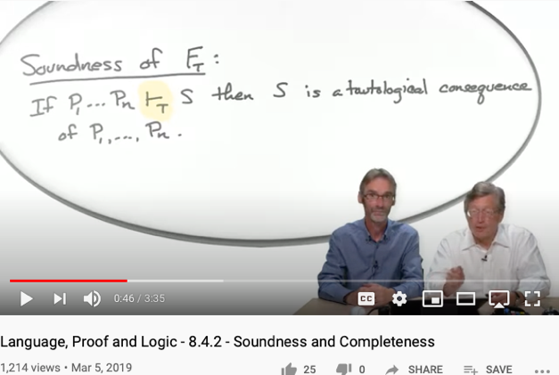
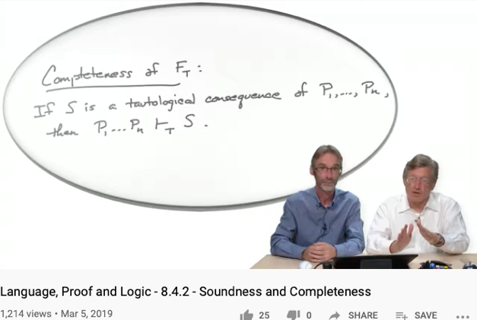
Soundness
Completeness
For engineering/scientific purpose, it is difficult to escape Monism
The unifying notion of “Truth” is the source of Monism
Every provable statement is true
Every true statement is provable
Cited from : Soundness and Completeness: With Precision on news.ycombinator.com
https://youtu.be/3hspKYIn5ds?t=29
https://youtu.be/3hspKYIn5ds?t=162

Slide 14
Efficiency
We have to implement various operations on n-bit binary numbers (n = 16, 32, 64, ...).
For example, consider multiplication
Naïve algorithm: to multiply x*y: { for i = 1 ... y do sum = sum + x }
Run-time is proportional to y
In a 64-bit system, y can be as large as 2^{64.}
Multiplications can take years to complete
Algorithms that operate on n-bit inputs can be either:
Naïve: run-time is proportional to the value of the n-bit inputs
Good: run-time is proportional to n, the input’s size.

Slide 15
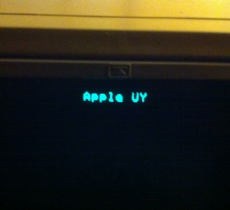

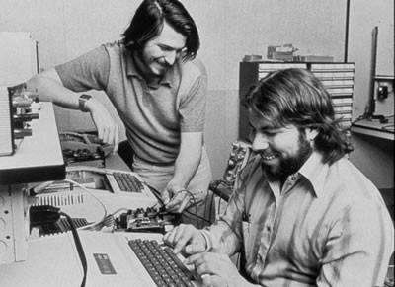
A historic moment remembered
… Wozniak began writing the software that would get the microprocessor to display images on the screen. After a couple of month he was ready to test it. “I typed a few keys on the keyboard and I was shocked! The letters were displayed on the screen.”
It was Sunday, June 29, 1975, a milestone for the personal computer. “It was the first time in history,” Wozniak later said, “anyone had typed a character on a keyboard and seen it show up on their own computer’s screen right in front of them”
(Steve Jobs, by Walter Isaacson, 2012)

Slide 16
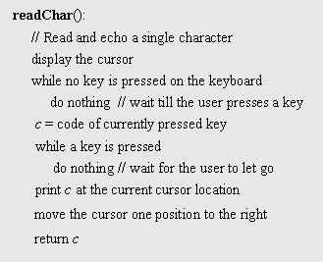
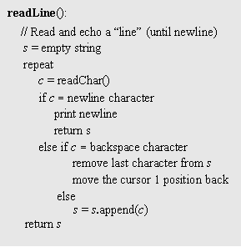

Keyboard input (cont.)

Slide 17
Jack OS recap
Project 12:
Build it.
class Math {
function void init()
function int abs(int x)
Class String {
Class Array {
function Array new(int size)
method void dispose()
}
class Output {
Class Screen {
class Memory {
function int peek(int address)
Class Keyboard {
Class Sys {
function void halt():
function void error(int errorCode)
function void wait(int duration)
}
Implementation: just like GNU Unix and Linux were built:
Start with an existing system, and gradually replace it with a new system, one library at a time.

Slide 18
Perspective
What we presented can be described as a:
mini OS
Standard library
Many classical OS functions are missing
No separation between user mode and OS mode
Some algorithms (e.g. multiplication and division) are standard
Other algorithms (e.g. line- and circle-drawing) can be accelerated with special hardware
And, by the way, we’ve just finished building the computer.

Slide 19
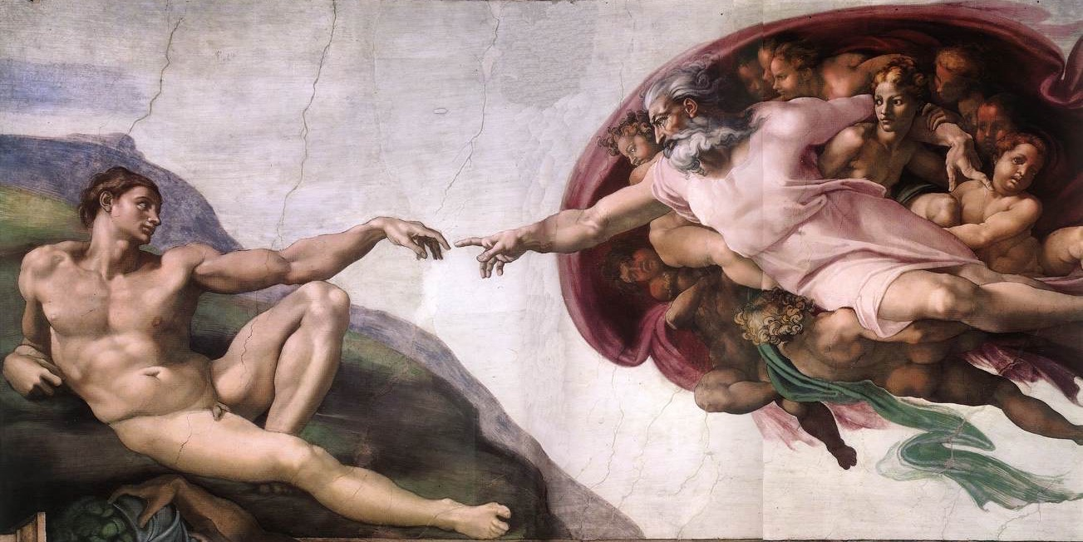
Here’s Nand; Go build a computer
Nand
In CS, God gave us Nand
Everything else was done by humans.

Slide 20
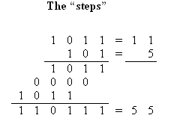
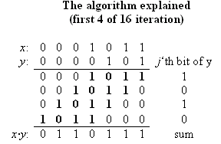
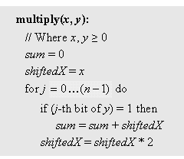
Example I: multiplication
Run-time: proportional to n
Can be implemented in SW or HW
Division: similar idea.

Slide 21
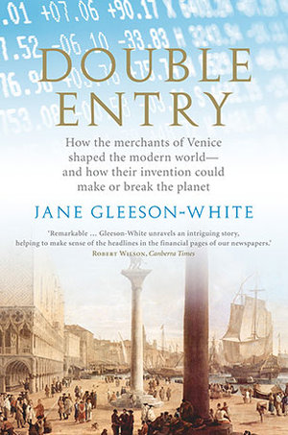
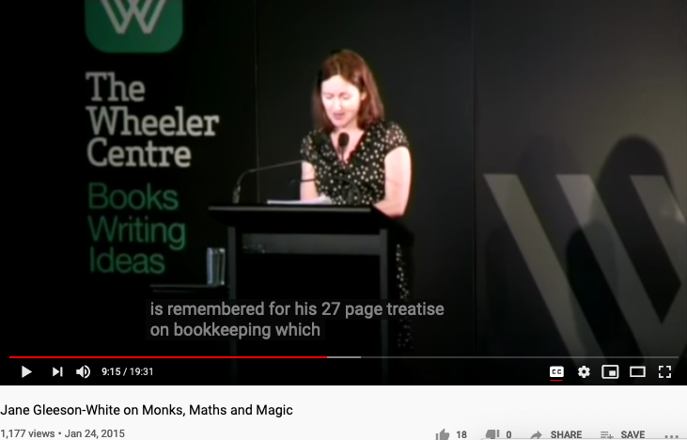
Double Entry, Monks, Maths, and Magic

Slide 22

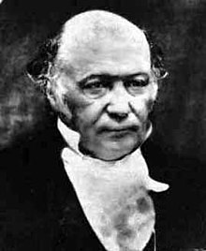
Hamiltonian Mechanics make energy Accountable
Assets = Liability + Equity
and
H = T + V
These two equations basically dominated two fields: Economics and Physical Sciences
Thinking from a Meta-Mathematical viewpoint,
they present a way to break down the total amount of conservative resources,
and therefore, allows iterative branching and therefore continuous replication.
Notes:
“historian James Aho linked double-entry bookkeeping to the ancient art of rhetoric,”
Excerpt From: Jane Gleeson-White. “Double Entry.” Apple Books.

Slide 23
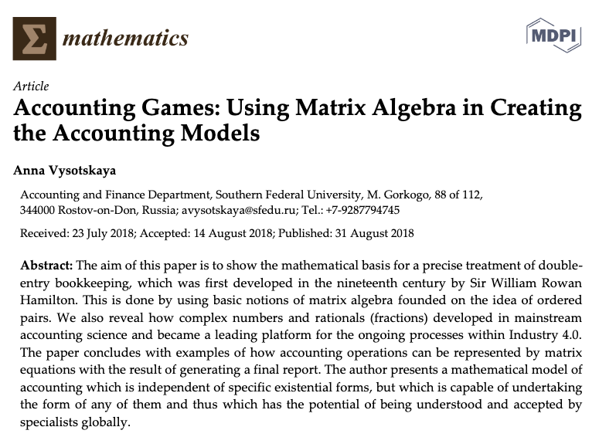

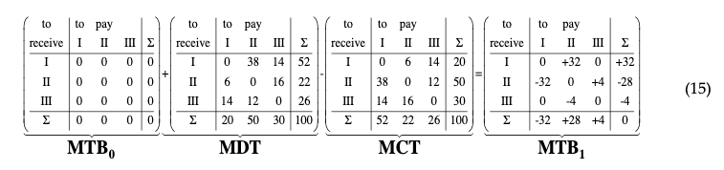
Hamilton did more work on the Accounting Equation
The aim of this paper is to show how the mathematical basis is used for a precise treatment of double-entry bookkeeping, which was firstly developed in the nineteenth century by Sir William Rowan Hamilton. This is done by using basic notions of matrix algebra with the roots to the idea of using ordered pairs. We also reveal how the complex numbers and the rationals (fractions) developed in a mainstream of accounting science and became a leading platform for the ongoing processes within the Industry 4.0.
Image Source: Research Gate
Notes:
In the presentation on Oct-9, 2020, Ray again, stated a link between the Atomic Explosion’s 20 thousands generations of chain reactions and the layers of Syntatic Trees in Chomsky’s Syntactic Theory about language. Then, he also reminded us that Chomsky and Shannon were working in locations that are 100 feet away from each other. The white and black dots are demonstrating the patterns of Fibonacci series.

Slide 24
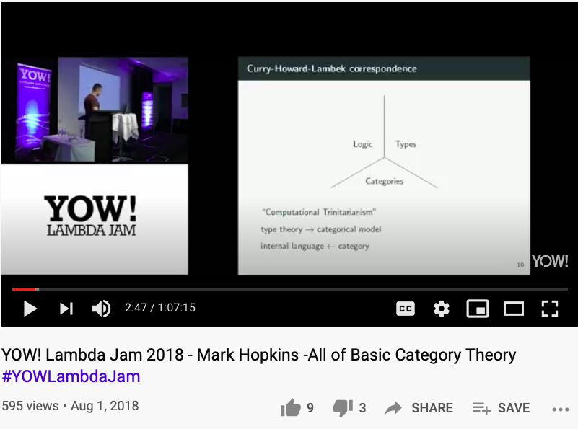
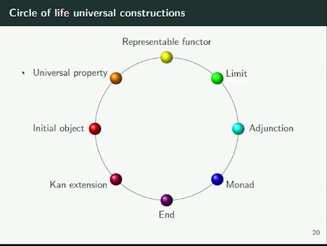
Kan Extension and other ideas in Category Theory
Huawei VP Mr. Yang Shaoqing
All these terms are equivalent…
they can be refomulated into each other…
https://youtu.be/9u1q3lH7VbE （video stops at 33:12）

Slide 25
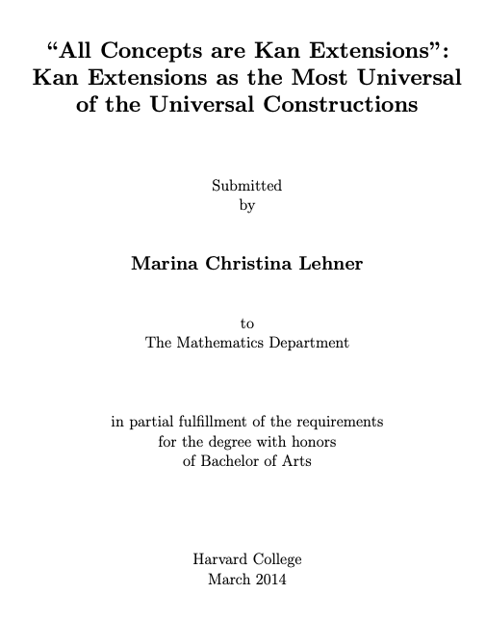
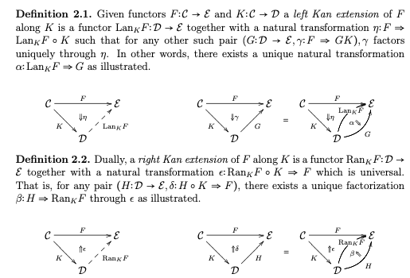
Kan Extension makes concepts Representable
Huawei VP Mr. Yang Shaoqing

Slide 26
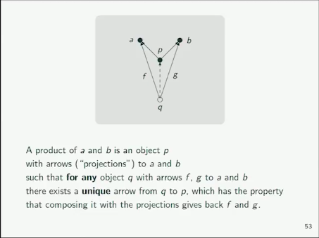
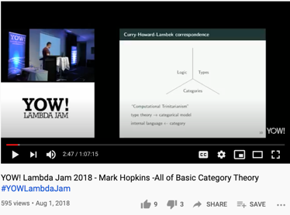
The ideas of Universality
Huawei VP Mr. Yang Shaoqing
https://youtu.be/9u1q3lH7VbE?t=962（explaination starts at 16:02）

Slide 27
When explaining the idea of Universal Properties …
We have explained certain aspects of all other properties in the ring.
Huawei VP Mr. Yang Shaoqing

Slide 28
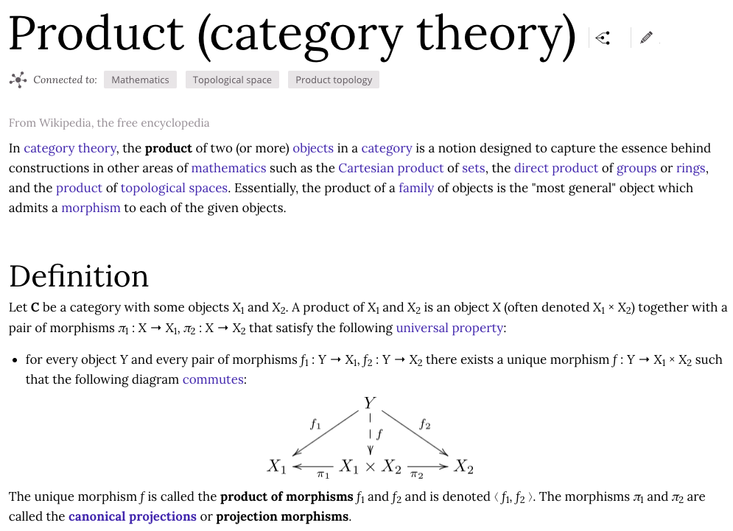
Example I: multiplication explained in Category Theory
Image Source: Wikipedia (through Wikiwand)

Slide 29
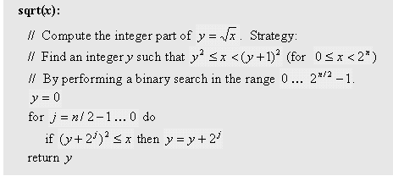
Example II: square root
The square root function has two convenient properties:
It’s inverse function is computed easily
Monotonically increasing
Functions that have these two properties can be computed by binary search:
Number of loop iterations is bounded by n/2, thus the run-time is O(n).

Slide 30
Math operations (in the Jack OS)
class Math {
class String {
class Array {
class Output {
class Math {
function void init()
function int abs(int x)
function int multiply(int x, int y)
function int divide(int x, int y)
function int min(int x, int y)
function int max(int x, int y)
function int sqrt(int x)
}
class Screen {
class Memory {
class Keyboard {
class Sys {
function (…)
…
}



The remaining functions are simple to implement.

Slide 31
String processing (in the Jack OS)
class Math {
class String {
Class String {
constructor String new(int maxLength)
method void dispose()
method int length()
method char charAt(int j)
method void setCharAt(int j, char c)
method String appendChar(char c)
method void eraseLastChar()
method int intValue()
method void setInt(int j)
function char backSpace()
function char doubleQuote()
function char newLine()
}
class Array {
class Output {
class Screen {
class Memory {
class Keyboard {
class Sys {
function (…)
…
}

Slide 32
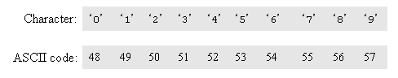
Single digit ASCII conversions
asciiCode(digit) == digit + 48
digit(asciiCode) == asciiCode - 48

Slide 33
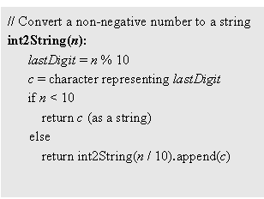
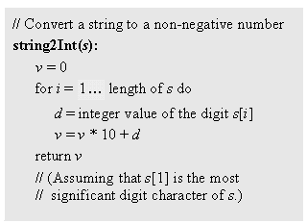
Converting a number to a string
SingleDigit–to-character conversions: done
Number–to-string conversions:

Slide 34
Memory management (in the Jack OS)
class Math {
class String {
class Array {
class Output {
class Screen {
class Memory {
class Keyboard {
class Sys {
function (…)
…
}
class Memory {
function int peek(int address)
function void poke(int address, int value)
function Array alloc(int size)
function void deAlloc(Array o)
}

Slide 35
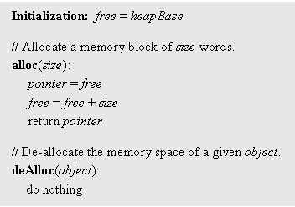
Memory management (naive)
When a program constructs (destructs) an object, the OS has to allocate (de-allocate) a RAM block on the heap:
alloc(size): returns a reference to a free RAM block of size size
deAlloc(object): recycles the RAM block that object refers to
The data structure that this algorithm manages is a single pointer: free.

Slide 36
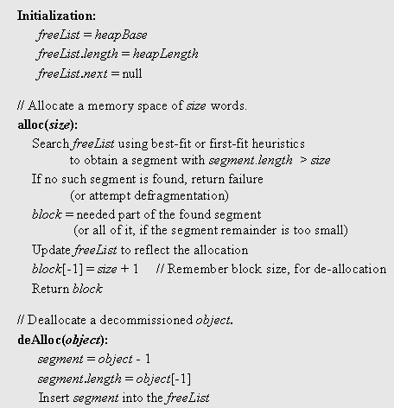
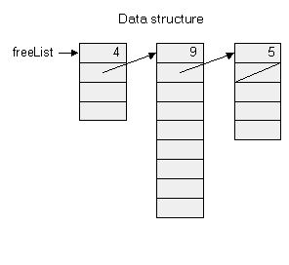
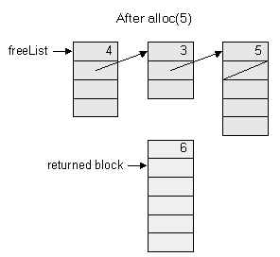
Memory management (improved)

Slide 37
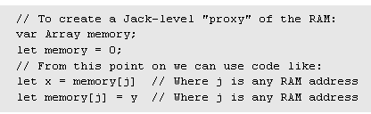
Peek and poke
class Memory {
function int peek(int address)
function void poke(int address, int value)
function Array alloc(int size)
function void deAlloc(Array o)
}
Implementation: based on our ability to exploit exotic casting in Jack:

Slide 38
Graphics primitives (in the Jack OS)
class Math {
class String {
class Array {
class Output {
class Screen {
class Memory {
class Keyboard {
class Sys {
function (…)
…
}
Class Screen {
function void clearScreen()
function void setColor(boolean b)
function void drawPixel(int x, int y)
function void drawLine(int x1, int y1, int x2, int y2)
function void drawRectangle(int x1, int y1,int x2, int y2)
function void drawCircle(int x, int y, int r)
}

Slide 39
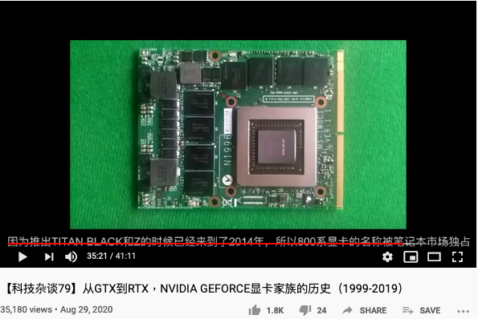
A History of Graphics Acceleration Hardware
https://youtu.be/UUxUCVlXV0A

Slide 40
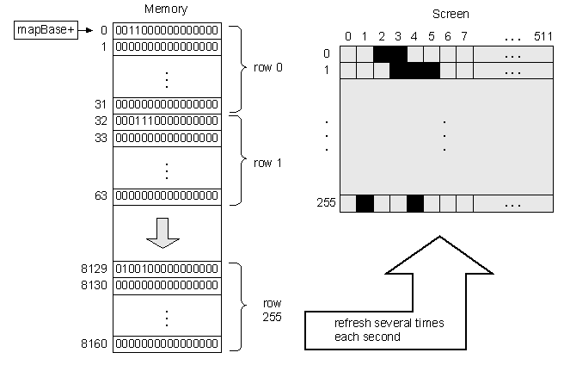
Memory-mapped screen

Slide 41
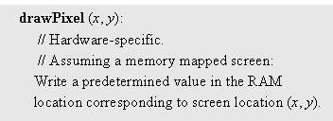
Pixel drawing
Implementation: using poke(address,value)

Slide 42
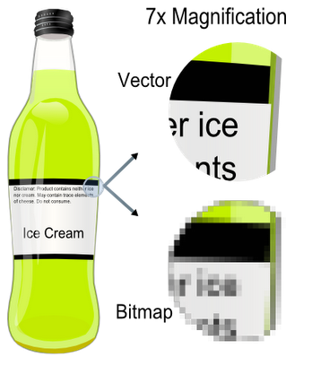
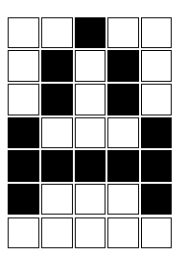
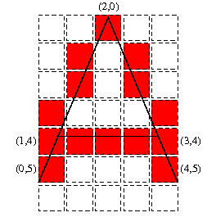
Image representation: bitmap versus vector graphics
pixel
(0,0)
bitmap
vector
Bitmap file: 00100, 01010,01010,10001,11111,10001,00000, . . .
Vector graphics file: drawLine(2,0,0,5), drawLine(2,0,4,5), drawLine(1,4,3,4)
Pros and cons of each method.
Notes:
42

Slide 43

Vector graphics: basic operations
0
1
2
3
.
.
.
drawPixel(x,y)
(Primitive operation)
0
1
drawLine(x1,y1,x2,y2)
2
3
Screen =
grid of pixels
drawCircle(x,y,r)
.
.
drawRectangle(x1,y1,x2,y2)
.
drawTriangle(x1,y1,x2,y2,x3,y3)
etc. (a few more similar operations)
0
1
2
3
4
5
6
7
8
9
10
11
12
13
0
1
drawLine(0,3,0,11)
drawRectangle(1,3,5,9)
drawLine(1,12,2,12)
drawLine(3,10,3,11)
drawLine(6,4,6,9)
drawLine(7,0,7,12)
drawLine(8,1,8,12)
2
3
4
5
6
7
8
9
Notes:
43

Slide 44
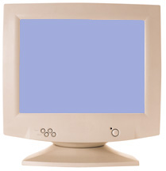
How to draw a line?
drawLine(x1,y1,x2,y2)
Basic idea: drawLine is implemented through a sequence of drawPixel operations
Challenge 1: which pixels should be drawn ?
Challenge 2: how to draw the line fast ?
Simplifying assumption: the line that we are asked to draw goes north-east.
Notes:
44

Slide 45
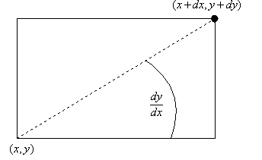
Line Drawing
Given: drawLine(x1,y1,x2,y2)
Notation: x=x1, y=y1, dx=x2-x1, dy=y2-y1
Using the new notation: We are asked to draw a line between (x,y) and (x+dx,y+dy)
dy
dx
set (a,b) = (0,0)
while there is more work to do
drawPixel(x+a,y+b)
decide if you want to go right, or up
if you decide to go right, set a=a+1; if you decide to go up, set b=b+1
set (a,b) = (0,0)
while (a ≤ dx) and (b ≤ dy)
drawPixel(x+a,y+b)
decide if you want to go right, or up
if you decide to go right, set a=a+1; if you decide to go up, set b=b+1
Notes:
45

Slide 46
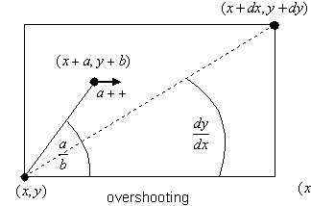
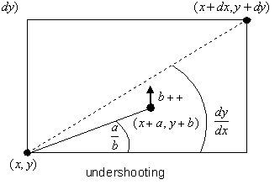
Line Drawing algorithm
drawLine(x,y,x+dx,y+dy)
set (a,b) = (0,0)
while (a ≤ dx) and (b ≤ dy)
drawPixel(x+a,y+b)
decide if you want to go right, or up
if you decide to go right, set a=a+1; if you decide to go up, set b=b+1
drawLine(x,y,x+dx,y+dy)
set (a,b) = (0,0)
while (a ≤ dx) and (b ≤ dy)
drawPixel(x+a,y+b)
if b/a > dy/dx set a=a+1 else set b=b+1
Oy Vey
Notes:
46

Slide 47
Line Drawing algorithm, optimized
Motivation
When you draw polygons, e.g. in animation or video, you need to draw millions of lines
Therefore, drawLine must be ultra fast
Division is a very slow operation
Addition is ultra fast (hardware based)
drawLine(x,y,x+dx,y+dy)
set (a,b) = (0,0)
while (a ≤ dx) and (b ≤ dy)
drawPixel(x+a,y+b)
if b/a > dy/dx set a=a+1 else set b=b+1
b/a > dy/dx is the same as a*dy < b*dx
Define diff = a*dy – b*dx
Let’s take a close look at this diff:
b/a > dy/dx is the same as diff < 0
When we set (a,b)=(0,0), diff = 0
When we set a=a+1, diff goes up by dy
When we set b=b+1, diff goes down by dx
drawLine(x,y,x+dx,y+dy)
set (a,b) = (0,0), diff = 0
while (a ≤ dx) and (b ≤ dy)
drawPixel(x+a,y+b)
if diff < 0 set a=a+1, diff = diff + dx else set b=b+1, diff = diff - dy
Notes:
47

Slide 48
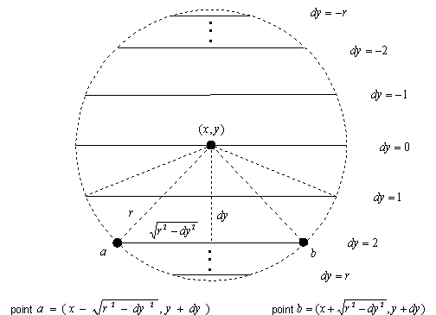
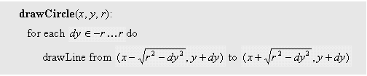
Circle drawing
The screen origin (0,0) is at the top left.

Slide 49
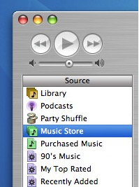
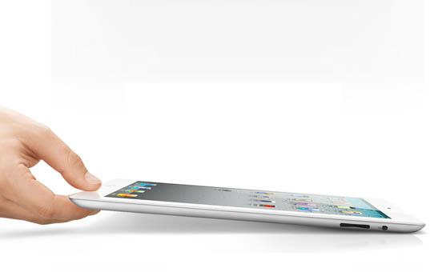
An anecdote about efficiency and design
… Jobs obsessed about the look of what would appear on the screen. One day Bill Atkinson burst into his office all excited. He had just come up with a brilliant algorithm that could draw circles onscreen quickly. The math for making circles usually required calculating square roots, which the Motorola 68000 microprocessor didn’t support. But Atkinson did a workaround based on the fact that the sum of a sequence of odd numbers produces a sequence of perfect squares (e.g. 1 + 3 = 4, 1 + 3 + 5 = 9, etc.)
When Atkinson fired up his demo, everyone was impressed except Jobs. “Well, circles are nice,” he said, “but how about drawing rectangles with rounded corners?”
(Steve Jobs, by Walter Isaacson, 2012)

Slide 50
To sum up (vector graphics)…
To do vector graphics (e.g. display a PPT file), you have to draw polygons
To draw polygons, you need to draw lines
To draw lines, you need to divide
Division can be re-expressed as multiplication
Multiplication can be reduced to addition
Addition is easy.
Notes:
50

Slide 51
Character output primitives (in the Jack OS)
class Math {
class String {
class Array {
class Output {
class Screen {
class Memory {
class Keyboard {
class Output {
function void moveCursor(int i, int j)
function void printChar(char c)
function void printString(String s)
function void printInt(int i)
function void println()
function void backSpace()
}
class Sys {
function (…)
…
}

Slide 52
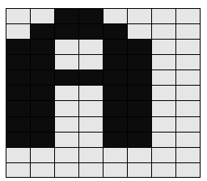
Character output
Given display: a physical screen, say 256 rows by 512 columns
We can allocate an 11 by 8 grid for each character
Hence, our output package should manage a 23 lines by 64 characters screen
Font: each displayable character must have an agreed-upon bitmap
In addition, we have to manage a “cursor”.

Slide 53
Font implementation (in the Jack OS)
class Output {
static Array charMaps;
function void initMap() {
let charMaps = Array.new(127);
// Assign a bitmap for each character
do Output.create(32,0,0,0,0,0,0,0,0,0,0,0); // space
do Output.create(33,12,30,30,30,12,12,0,12,12,0,0); // !
do Output.create(34,54,54,20,0,0,0,0,0,0,0,0); // “
do Output.create(35,0,18,18,63,18,18,63,18,18,0,0); // #
...
do Output.create(48,12,30,51,51,51,51,51,30,12,0,0); // 0
do Output.create(49,12,14,15,12,12,12,12,12,63,0,0); // 1
do Output.create(50,30,51,48,24,12,6,3,51,63,0,0); // 2
. . .
do Output.create(65,0,0,0,0,0,0,0,0,0,0,0); // A ** TO BE FILLED **
do Output.create(66,31,51,51,51,31,51,51,51,31,0,0); // B
do Output.create(67,28,54,35,3,3,3,35,54,28,0,0); // C
. . .
return;
}
// Creates a character map array
function void create(int index, int a, int b, int c, int d, int e,
int f, int g, int h, int i, int j, int k) {
var Array map;
let map = Array.new(11);
let charMaps[index] = map;
let map[0] = a;
let map[1] = b;
let map[2] = c;
...
let map[10] = k;
return; }

Slide 54
Keyboard primitives (in the Jack OS)
class Math {
class String {
class Array {
class Output {
class Screen {
class Memory {
class Keyboard {
class Sys {
function (…)
…
}
Class Keyboard {
function char keyPressed()
function char readChar()
function String readLine(String message)
function int readInt(String message)
}

Slide 55

Keyboard input
If the RAM address of the keyboard’s memory map is known, the above logic can be implemented using a peek function
Problem I: the elapsed time between a “key press” and key release” events is unpredictable
Problem II: when pressing a key, the user should get some visible feedback (cursor, echo, ...).

Slide 56


Some Final notes
CS is a science
What is science?
Reductionism
Life science: From Aristo (millions of rules) to Darwin (3 rules) to Watson and Crick (1 rule)
Computer science: We knew in advance that we could build a computer from almost nothing. In this course we actually did it.
Key lessons:
Elegance
Clarity
Simplicity
Playfulness.

Slide 57

Operating System as a Program that Runs Forever -- Lamport

Slide 58

Operating System as a Program that Runs Forever -- Lamport
https://youtu.be/6MJUGVFAXKg?t=114

Slide 59



A Lattice-based Framework to analyze code

Slide 60


Accountants’ Value Proposition
The International
Integrated Reporting
Framework
Dec. 2013
Notes:
“historian James Aho linked double-entry bookkeeping to the ancient art of rhetoric,”
Excerpt From: Jane Gleeson-White. “Double Entry.” Apple Books.

Slide 61



An Operating System based on Causal Structures of Events
https://youtu.be/hAWyex1GKRU?t=778

Slide 62


Computational Laws and Consciousness
https://youtu.be/3WXTX0IUaOg?t=136

Slide 63


It is all in the Names

Slide 64


Saunders Mac Lane: Founder of Category Theory
Categories, Functors and Natural Transformation.
Constructions on Categories.
Universals and Limits.
Adjoints.
Limits.
Monads and Algebras.
Monoids.
Abelian Categories.
Special Limits.
Kan Extensions.
Symmetry and Braiding in Monoidal Categories.
Structures in Categories.
Tables of Categories. Bibliography.
Saunders Mac Lane (Wikipedia)

Slide 65

From Monism, Dualism to Cyber-physical Systems
Image Source: Double-aspect Theory on Wikipedia

Slide 66




Wiener’s Framing of Societal Values

Slide 67


The Abstract and Concrete Domains
Dockerized app services as the
Data Plane
Kubernetes as the Control Plane

Slide 68
Conclusion/Summary
A cognitive foundation based on Unitary Computing System:
Easier to find isomorphism due to the compact Name Space
Kan Extension refers to Adjoint Function/Galois Connection/Approximation
Mathematical ideas named after human names shows that we are still belief in human
Cybernetics is being realized with tools such as Kubernetes:
Many people can operate large scale named objects from distributed locations.
A different model of governance/magic is lurking…

